Slide 1
Deletion in Red-Black Trees

Slide 2
Red Black Tree
Red-Black tree is a binary search tree in which every node is colored with either red or black. It is a type of self balancing binary search tree.
Red Black Trees are self-balancing, meaning that the tree adjusts itself automatically after each insertion or deletion operation. It uses a simple but powerful mechanism to maintain balance, by coloring each node in the tree either red or black.

Slide 3
Red-Black Trees
The Red-Black tree satisfies all the properties of binary search tree in addition to that it satisfies following additional properties –
Root property: The root is black.
External property: Every leaf (Leaf is a NULL child of a node) is black in Red-Black tree.
Internal property: The children of a red node are black. Hence possible parent of red node is a black node.
Depth property: All the leaves have the same black depth.
Path property: Every simple path from root to descendant leaf node contains same number of black nodes.

Slide 4
Steps for Deletion in Red Black Trees
Deletion in Binary Search Tree
If the node to be deleted has no children, simply remove it and update the parent node.
If the node to be deleted has only one child, replace the node with its child.
If the node to be deleted has two children, then replace the node with its in-order successor, which is the leftmost node in the right subtree. Then delete the in-order successor node as if it has at most one child.
After the node is deleted, the red-black properties might be violated. To restore these properties perform
Recoloring
Rotations
The deletion operation in a red-black tree takes O(log n) time on average

Slide 5
Deletion Possible Cases
Let v be the node to be deleted and u be the child that replaces v (Note that u is NULL when v is a leaf and color of NULL is considered as Black).
Case 1: Normal deletion in Binary Search Tree, Delete V
Case 2: Simple Case: If either u or v is red
Case 3: If Both u and v are Black (Double Black)
If sibling s is black and at least one of sibling’s children is red,
If sibling is black and its both children are black.
If sibling is red
If u is root, make it single black and return

Slide 6
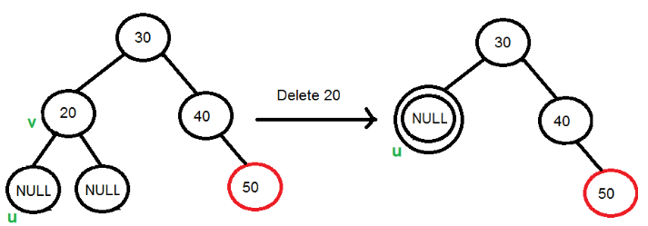
Double Black
When a black node is deleted and replaced by a black child, the child is marked as double black. The main task now becomes to convert this double black to single black

Slide 7
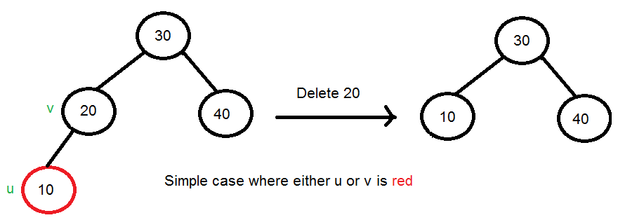
Case 2 - If either u or v is red

Slide 8
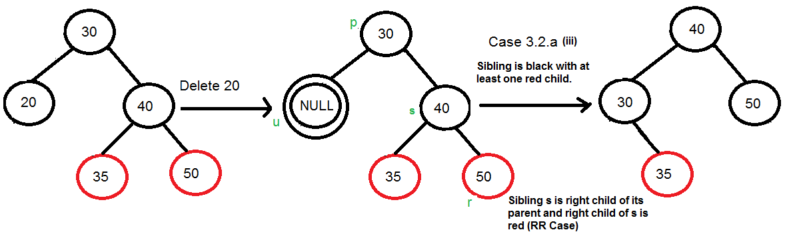
Case 3: If Both u and v are Black
If sibling s is black and at least one of sibling’s children is red,

Slide 9
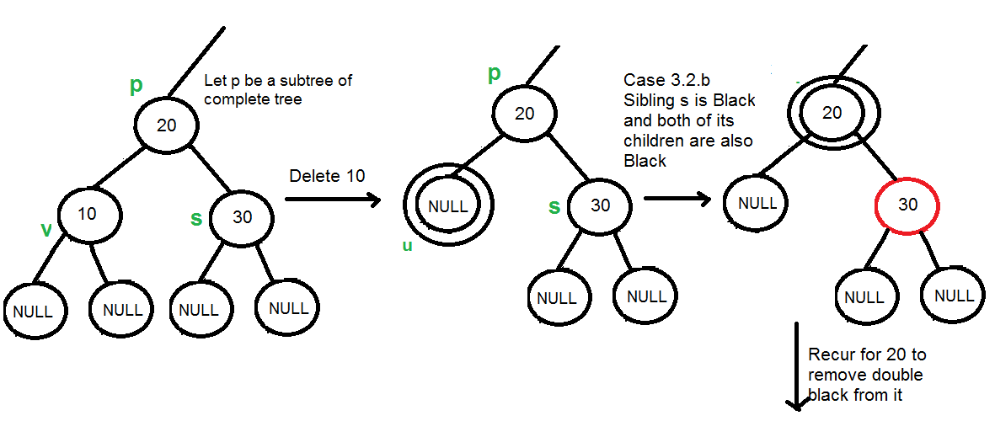
Case 3: If Both u and v are Black
If sibling is black and its both children are black.

Slide 10
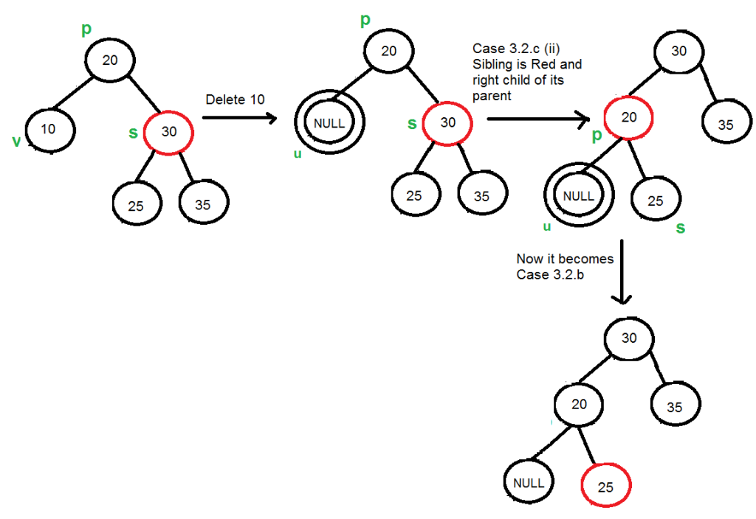
Case 3: If Both u and v are Black
If sibling is red

Slide 11
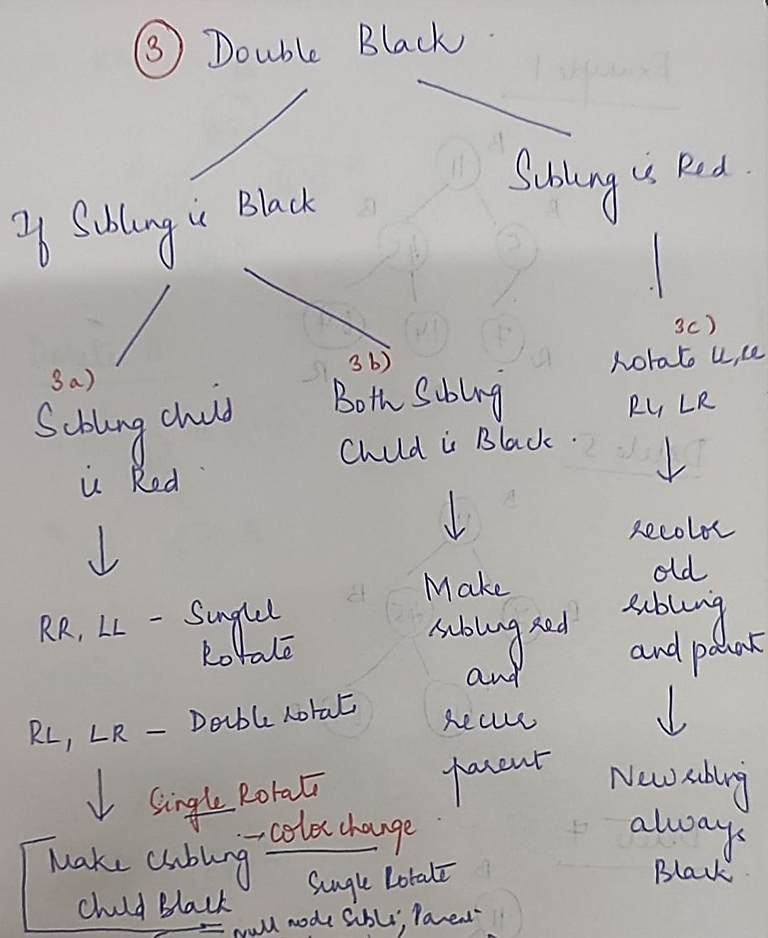
Double Black cases

Slide 12
Reference
https://www.geeksforgeeks.org/introduction-to-red-black-tree/
https://www.geeksforgeeks.org/insertion-in-red-black-tree/
https://www.geeksforgeeks.org/deletion-in-red-black-tree/
Introduction to Algorithms is a book on computer programming by Thomas H. Cormen, Charles E. Leiserson, Ronald L. Rivest, and Clifford Stein.

